Slide 1

Restoring Europe’s Forests: Benefits of the EU LIFE Programme for Society, Biodiversity, and Climate Objectives and expected outcomes of the Platform meeting
Simona Bacchereti, Boyana Vasileva
LIFE Platform meeting on “LIFE and European Forests Restoration”
Brasov, Romania 3 - 5 June 2025
Notes:
What is CINEA: European Climate, Infrastructure and Environment Executive Agency
CINEA plays a key role in supporting the EU Green Deal through the efficient and effective implementation of its delegated programmes.
EU Programs: part of Horizon Europe and three missions (Adaptation to Climate Change, Restore our Ocean and Waters by 2030 and 100 Climate-Neutral and Smart cities by 2030), Innovation Fund, European Maritime, Fisheries and Aquaculture Fund, CEF Transport and CEF Energy AND LIFE

Slide 2

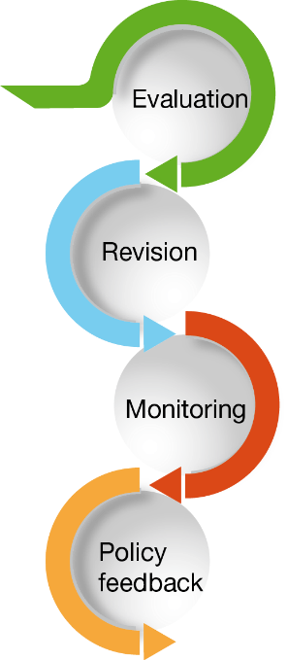

What is the EU LIFE Programme
Created in 1992 LIFE is the key European fund for nature conservation
Today LIFE programme as a whole constitutes a 100% contribution to the objectives and targets of the European Green Deal.
The only EU programme dedicated exclusively to the environment, nature conservation and climate action.
For the years 2021-2027, a budget of 5.43 billion €.

Slide 3
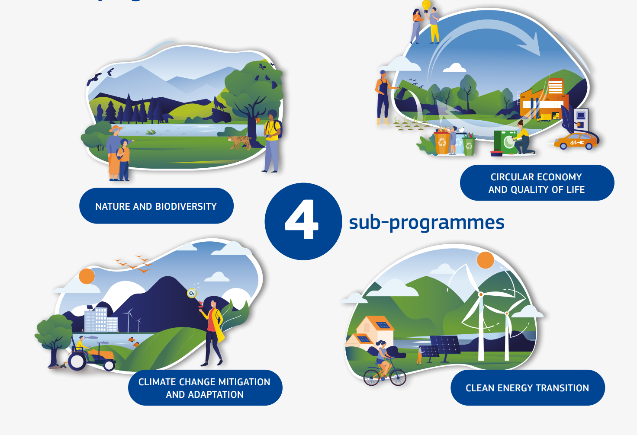
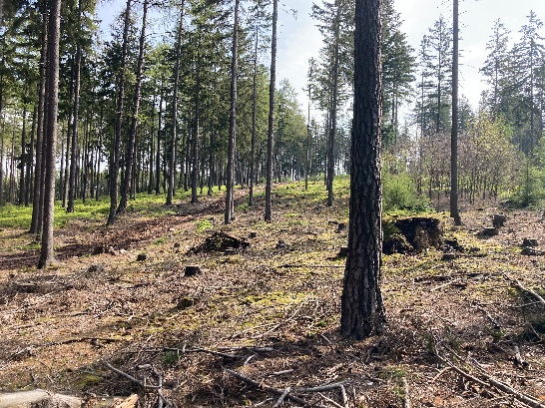
LIFE programme 2021-2027
Forest resilience
Peatlands restoration
€ 2.150 bln
€ 1.350 bln
LIFE21-CCA-CZ-LIFE Adapt Brdy
€ 0.950 bln
€ 1 bln
Notes:
To mention SAPs
SNAPs and SIPs

Slide 4
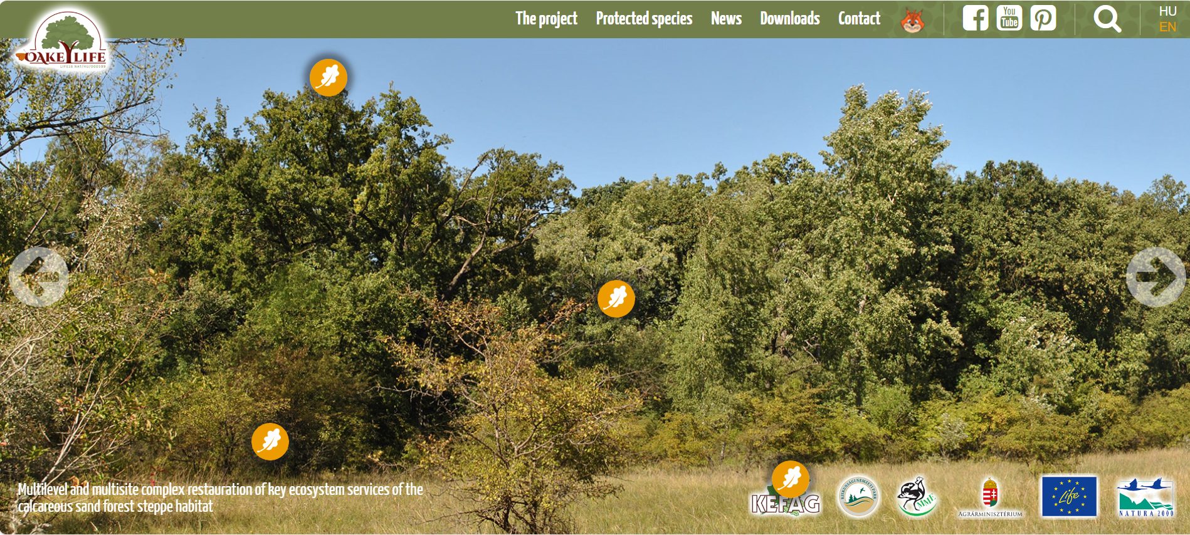
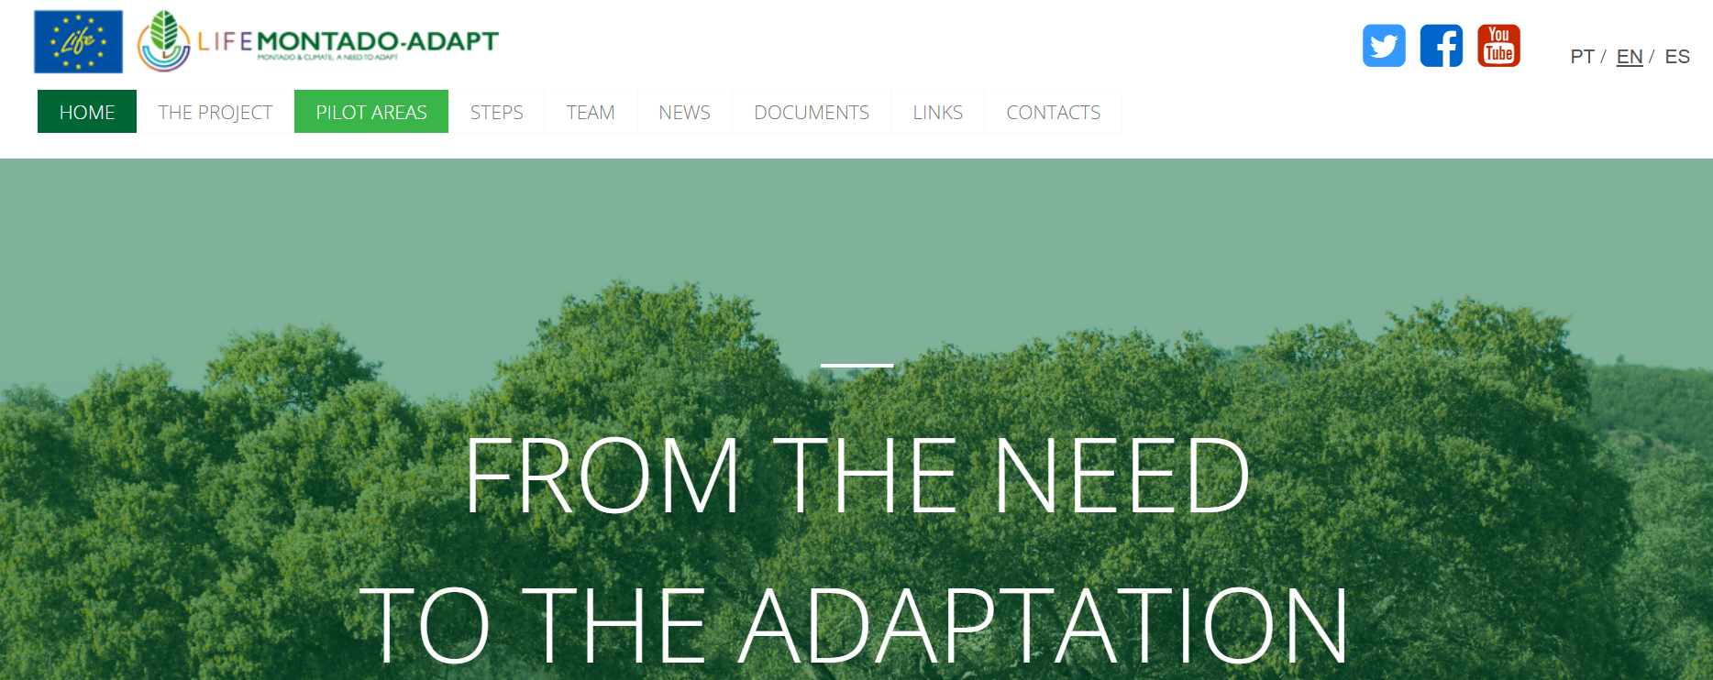
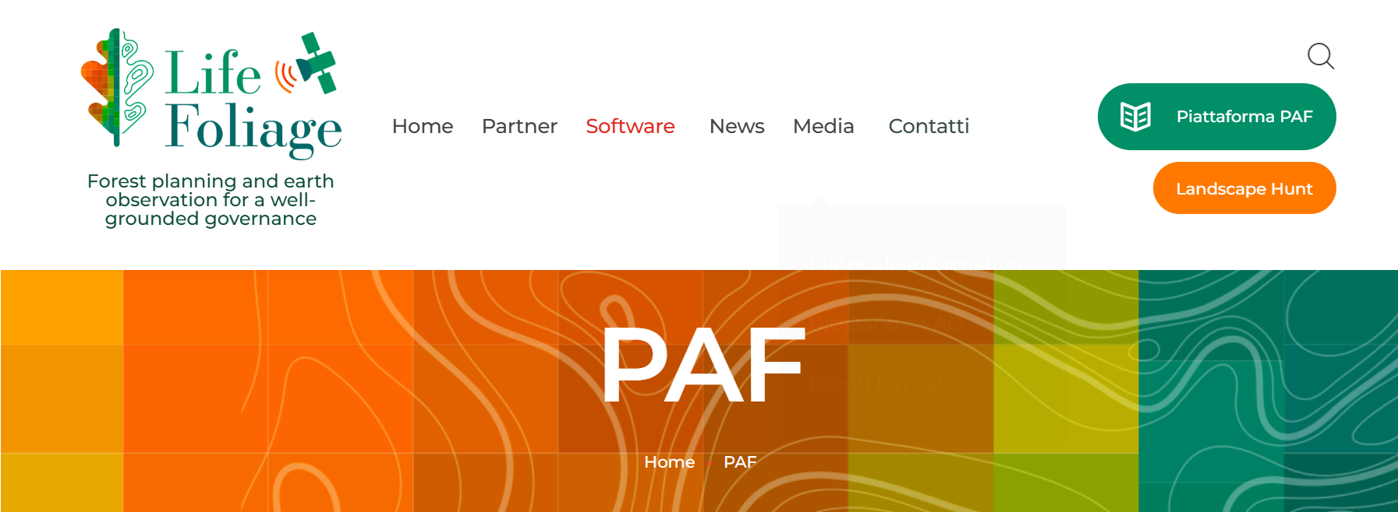
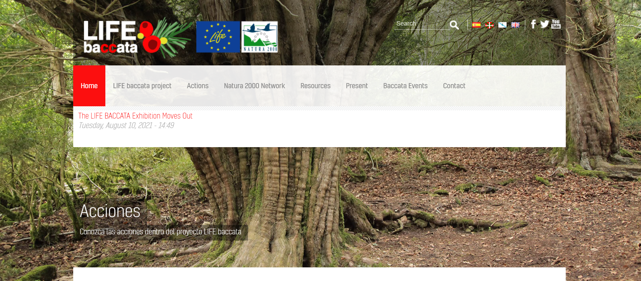
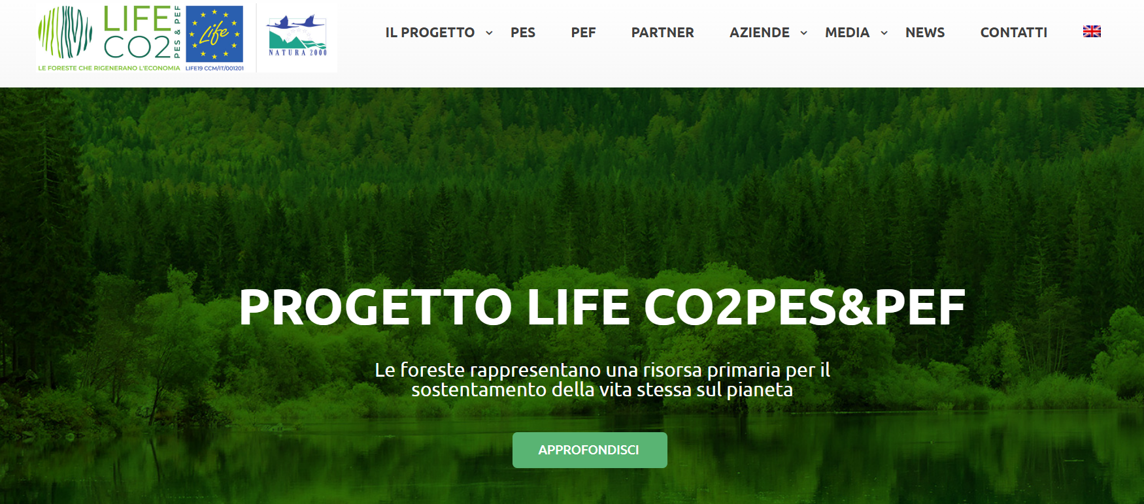
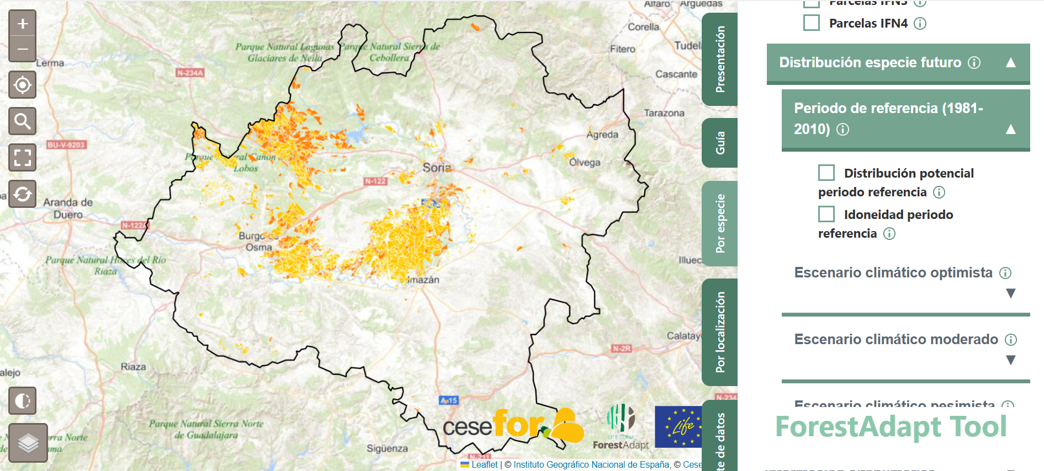
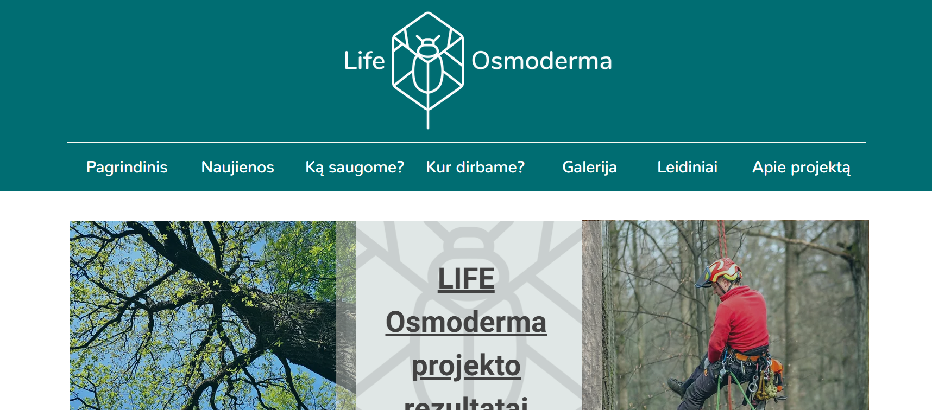
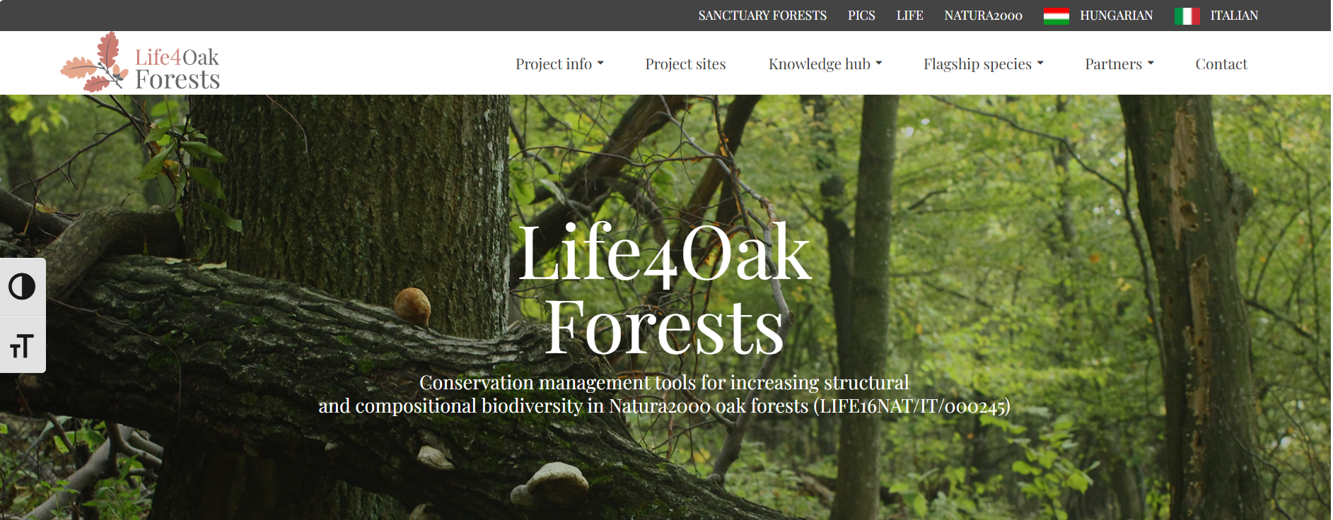

LIFE and Forests
Since 1992 about 650 projects with links to forest habitats have been implemented.
Between 2014 and 2023 the LIFE programme has funded over 170 LIFE projects preserving, adapting and restoring EU forests.

Slide 5
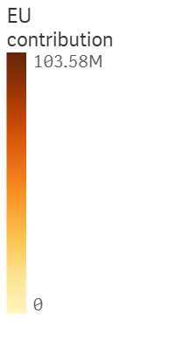
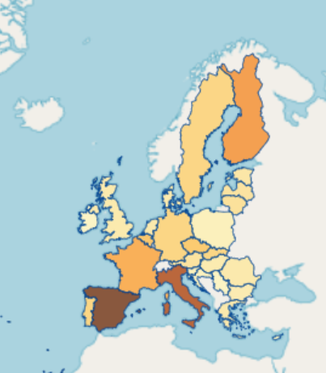
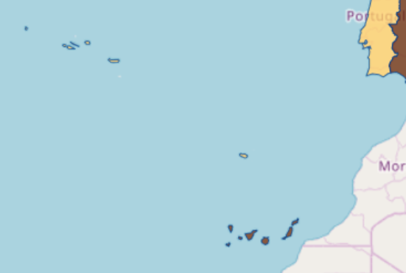
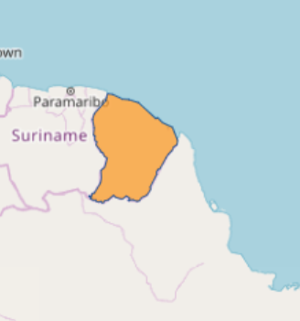
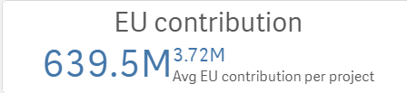
LIFE and Forests
Map distribution of LIFE forest projects between 2014-2023 and the EU contribution per country

Slide 6
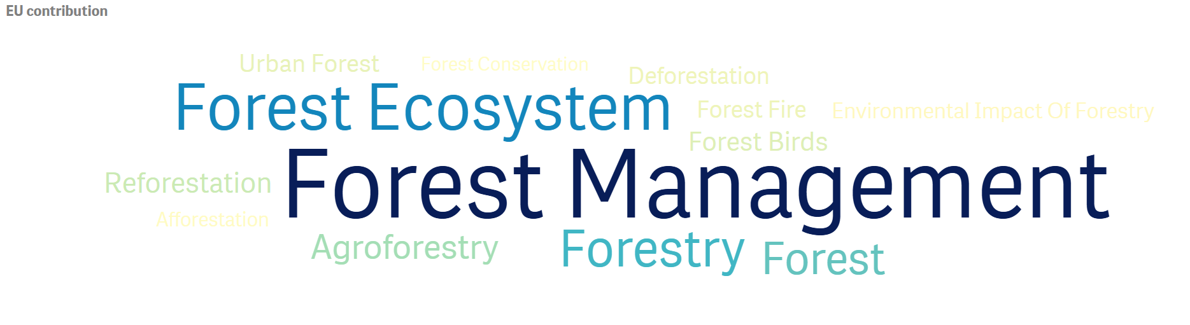
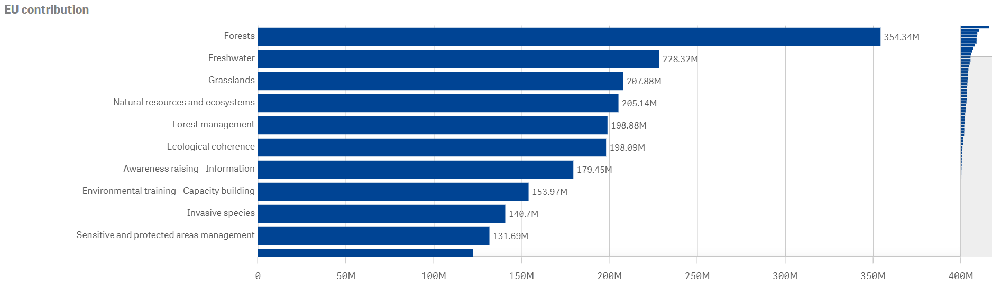
LIFE and Forests
Distribution of LIFE forest projects between 2014-2023 by theme and by EU contribution

Slide 7
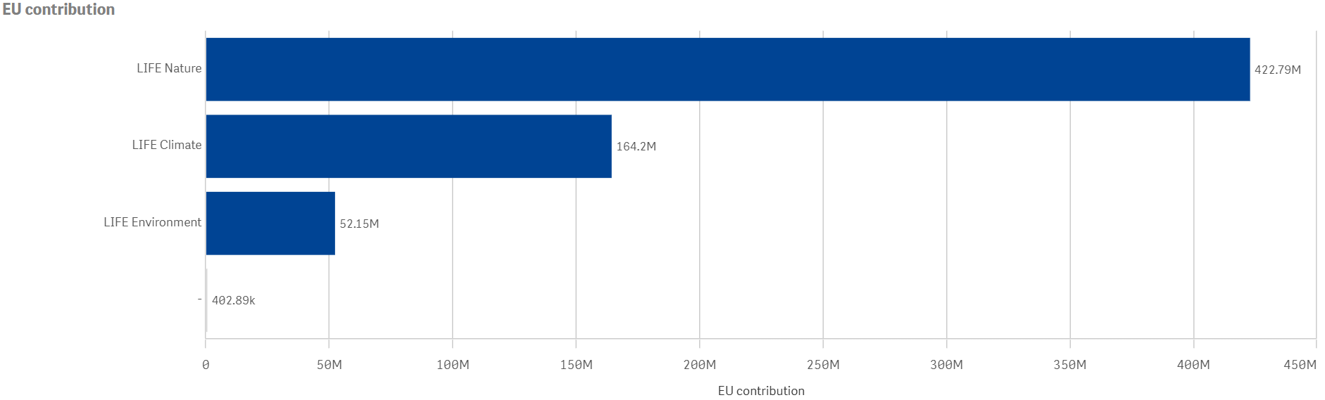
LIFE and Forests
Map distribution of LIFE forest projects between 2014-2023 and the EU contribution

Slide 8
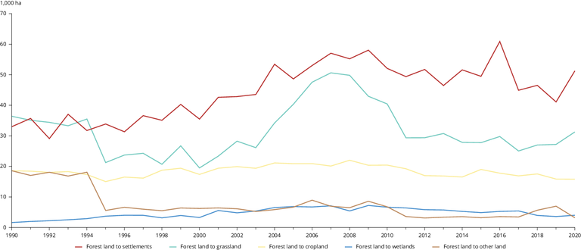
EU and forests
Forests constitute the largest terrestrial ecosystem in the EU-27, extending to around 160 million hectares.
over 90 % of the forests are predominantly semi-natural;
75% are composed of even-aged trees;
30% have only one species;
Primary and old-growth forests cover less than 4%;
Approximately 10% of the EU-27’s annual greenhouse gas emissions are absorbed and stored in forest soils and biomass;
Area of annually deforested land in the EU-27, 1990-2020
in 1000 ha. Deforestation in the EU-27 as collected by countries for the reporting on forest resources to the United Nations Economic Commission for Europe (UNECE), Food and Agriculture Organization (FAO) and Forest Europe processes, source: EEA

Slide 9
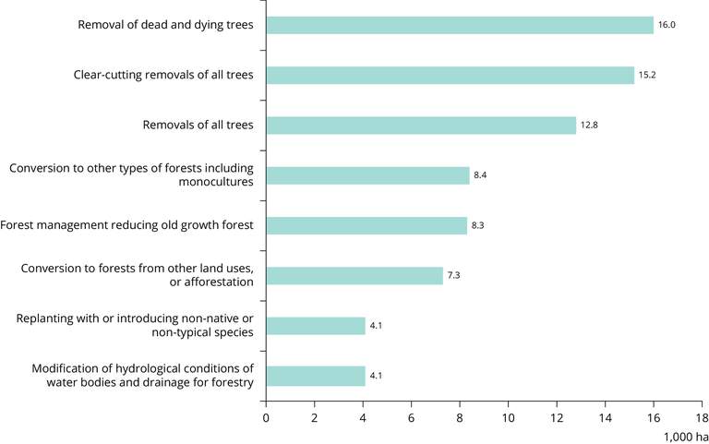
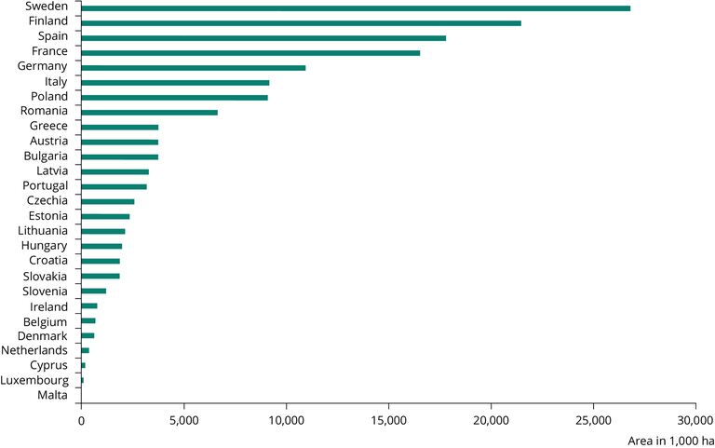
EU and forests
Forest area in the EU-27, 2020, Forest area in the EU-27 as collected by countries for the reporting on forest resources to the UNECE, FAO and Forest Europe processes, source: EEA 2020
Distribution of the eight most relevant pressures from forestry on forest habitats and species (2013-2018), source: EEA, 2020

Slide 10
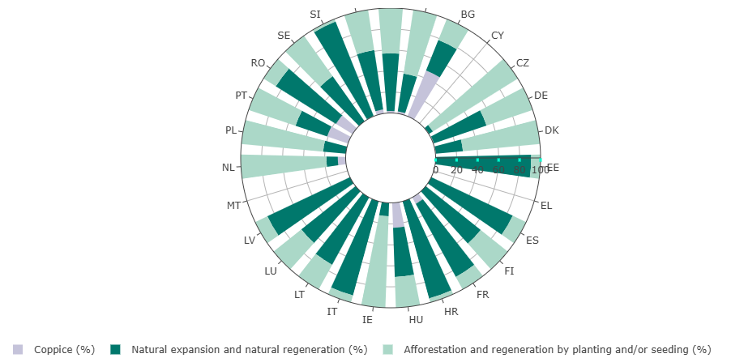
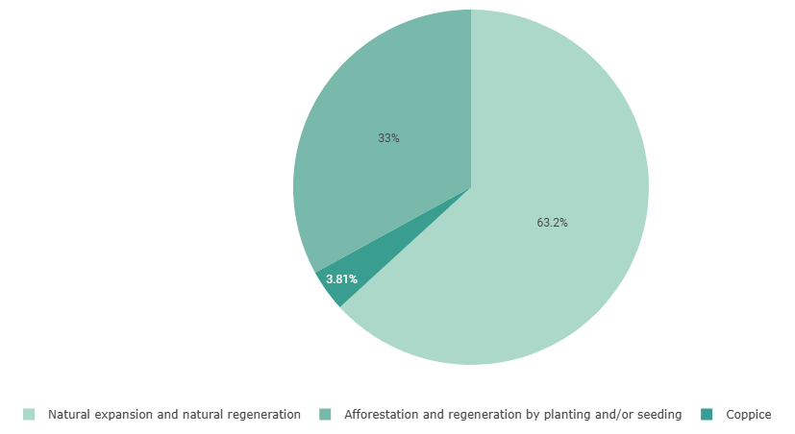
EU forest management
Types of regeneration of EU forests, source: FISE
Main regeneration practices per country, source: FISE

Slide 11
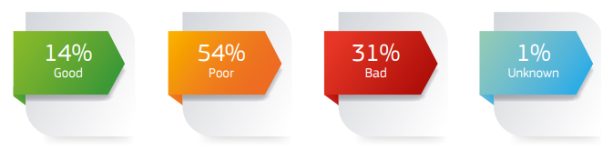
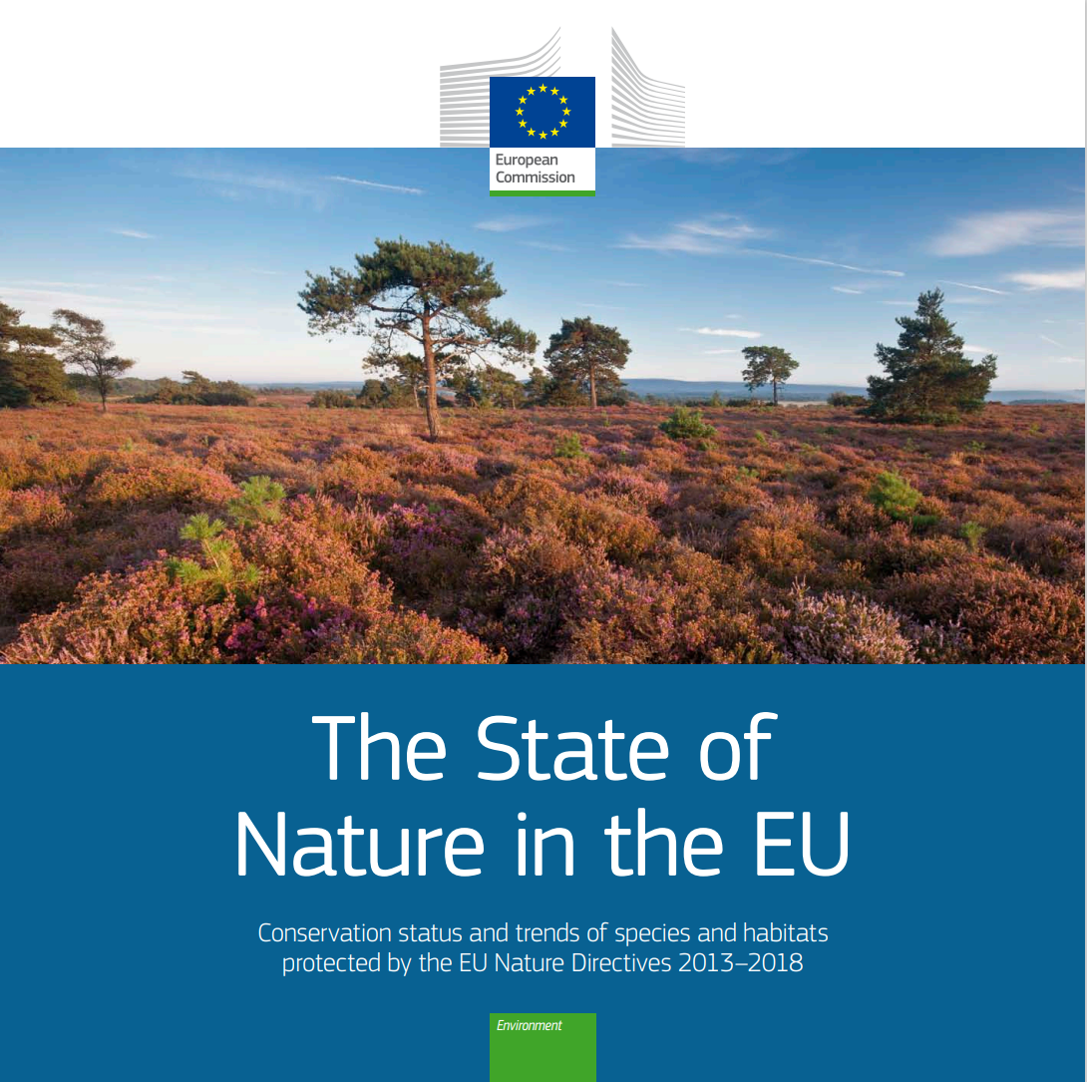
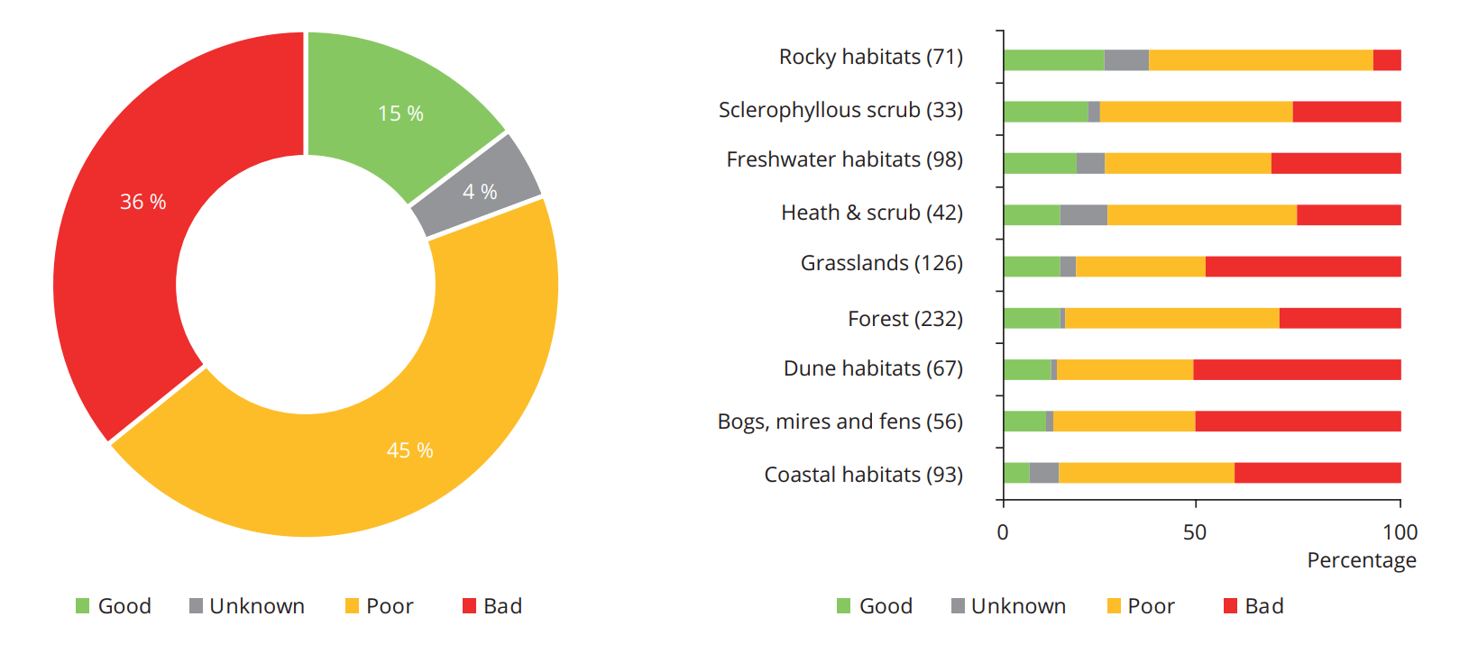
Forests – conservation status
Conservation status of habitats at EU level
Conservation status per habitat group at the EU level
Among habitat groups with a poor or bad conservation status, forests (13%) have the highest share with improving trends.
As for the 2013-2018 period, only 14% of forest habitats across the EU currently show a good status; 54% are in poor conservation status, 31% are in bad conservation status and 1% have an unknown conservation status.

Slide 12
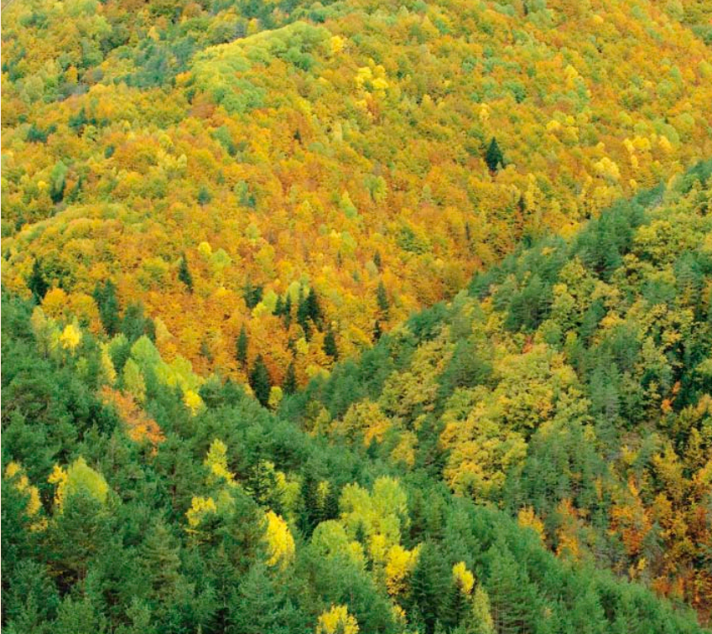
Restoration needs for EU protected habitats
The State of Nature report concludes that 215000 km2 (or 5% of EU-27 territory) of protected habitats need to have their condition improved.
Forests have the greatest need (about 100000 km2 ), followed by coastal habitats (about 46000 km2 ), grasslands (about 33000 km2 ), freshwater habitats (about 13500 km2 ) and bogs, mires and fens (about 10900 km2).

Slide 13
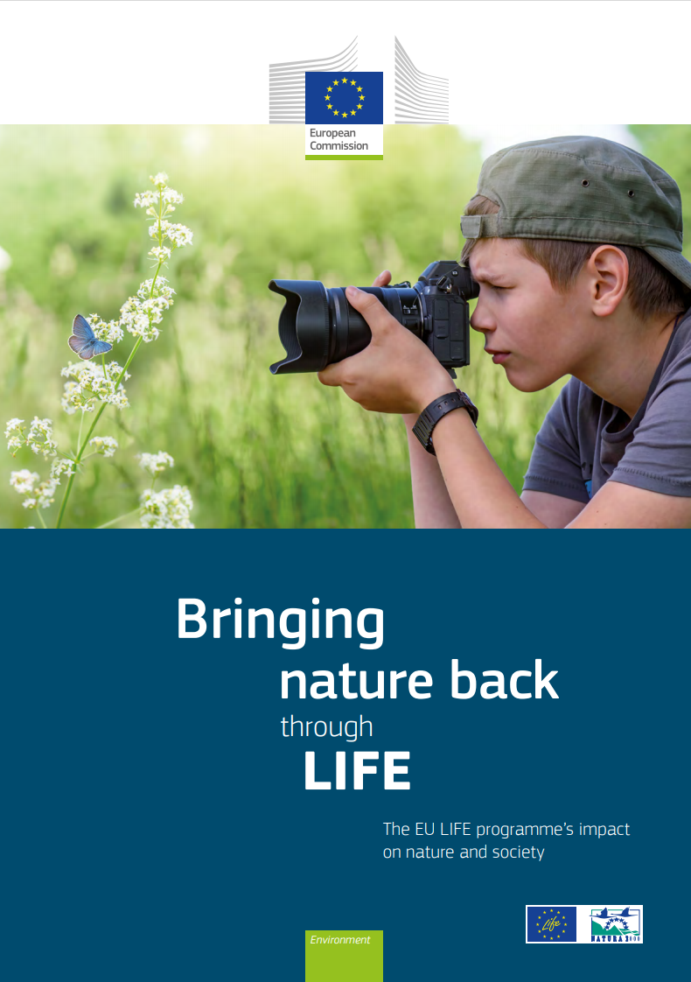
Gives and overview of:
the contribution of the LIFE programme for the improvement of conservation status of EU protected habitats and species
The role of LIFE for the EU Natura 2000 network
LIFE contribution to fighting IAS
Developing green infrastructure and nature-based solutions
Capacity building, combatting wildlife crime, public outreach and awareness
Conclusions:
LIFE has had a direct impact on the conservation status of numerous species and habitats
LIFE has been instrumental in raising awareness of Natura 2000 amongst millions of Europeans
LIFE has actively engaged thousands of stakeholders in the protection and management of sites , habitats and species
Impressive achievement, taking into consideration that it is a very small found (less than 1% of the EU budget)

Slide 14
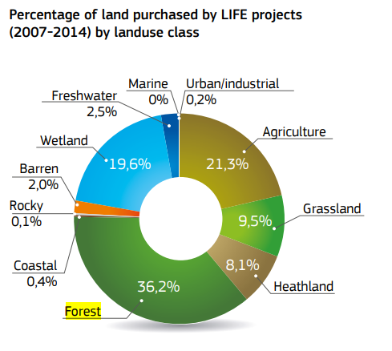
LIFE and forest habitats
LIFE Projects focusing on forests have to consider the pressures and drivers specific to the habitat type and region.
Key success factors of the programme’s forest-focused projects include strict adoption of sustainable forest management and land purchase to allow strict protection.
LIFE projects also look at sustainable forest management, afforestation prevention, invasive alien species and planting saplings.
Given the scale of forests and the long time needed to reach good status, LIFE impact can be seen mostly at local level.
Key successes are visible in rare habitats such as Macaronesian laurel forests (9360) and Western taïga (9010)

Slide 15
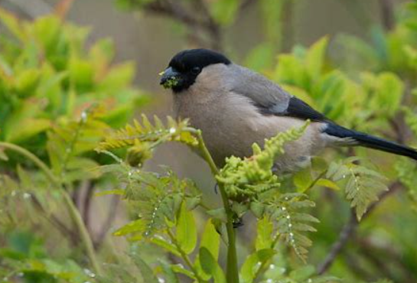
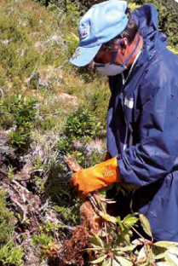
Success stories
The survival of the Critically Endangered Azores bullfinch (Pyrrhula murina), down to just 100 pairs in 2003, depends on the health of Macaronesian laurel forests.
Until recently, these forests were succumbing to invasive alien plant species which colonisers brought to the Azores long ago.
Three consecutive LIFE Projects - LIFE PRIOLO (LIFE03 NAT/P/000013), LIFE LAURISSILVA SUSTENTAVEL (LIFE07 NAT/P/000630) and LIFE Terras do Priolo (LIFE12 NAT/PT/000527) took on the main task of saving these forests and bird species for future generations – and appear to have succeeded.
These combined efforts have made a true difference. The conservation status of Macaronesian laurel forests improved from poor in 2012 to good in 2018, and the Azores bullfinch population has stabilised at between 630 and 2 000 individuals.

Slide 16
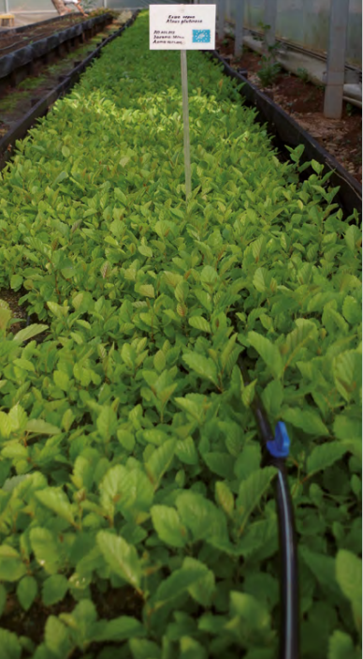
Success stories
In western Bulgaria, vast tracts of two priority forest habitats – Pannonian woods with Downy oak (Quercus pubescens) and alluvial forests with Common alder (Alnus glutinosa) and European ash (Fraxinus excelsior) – have been cut down in recent decades and replaced with commercial monocultures of non-native tree species.
Conservation and restoration actions for the Downy oak and European ash were carried out in two designated Natura 2000 network sites in the low mountains of western Bulgaria. The BGNATURAGENEFUND (LIFE10 NAT/BG/000146) project improved the conservation status of these species by stimulating natural regeneration patterns.
First, saplings were grown in nurseries from genetic material collected from a broad range of forest species. The project then reforested some 40 hectares within the two sites.
The growth and development of this newly planted forest enhanced habitat connectivity and improved the conservation status of the target habitats.
The project demonstrated to the Bulgarian forestry sector that reforestation and restoration of forest habitats deliver long-term environmental, economic and social benefits.

Slide 17
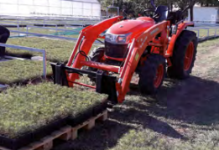
Success stories
Meanwhile, a combination of fires, pests, disease outbreaks and reckless human activity have damaged priority forests in south-west Bulgaria, and a lack of natural reproductive material makes their natural recovery more difficult.
The team of LIFEFORHAB (LIFE16 NAT/BG/000817) project constructed new tree nursery installations at the Lokorsko facility, which are the first of their kind in Bulgaria.
The project also raised the institutional capacity for replication of the project results, as well as the awareness regarding the conservation and restoration of woodland and forest habitats.
The project beneficiaries demonstrated good practices for restoring forest habitats in all targeted areas.
The project resulted in improvements in the conservation status and the extent of seven priority forest habitats of the Habitats Directive, in six Bulgarian NATURA 2000 network sites.

Slide 18
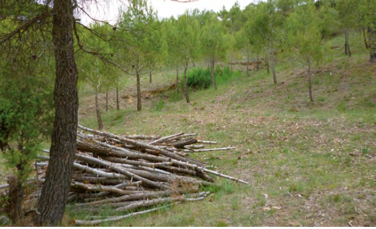
LIFE’s support for sustainable forestry
Intensive resource-harvesting practices are in large part to blame for Europe’s continuing biodiversity decline.
Forestry is a vital human industry but also cause a great deal of harm to species, habitats and ecosystems when left to operate in ways that are unsustainable.
LIFE projects are helping to encourage sustainable practices across sectors while increasing ecosystem benefits.
LIFEMontserrat (LIFE13 BIO/ES/000094) implemented a local land management model at Spain’s Montserrat mountain range, an area prone to recurring forest fires. Project work in pine woodlands reduced tree density to bring livestock grazing into the forest. This brought increased commercial forest value, enabled the establishment of new livestock farms and enhanced overall biodiversity through habitat diversification.

Slide 19
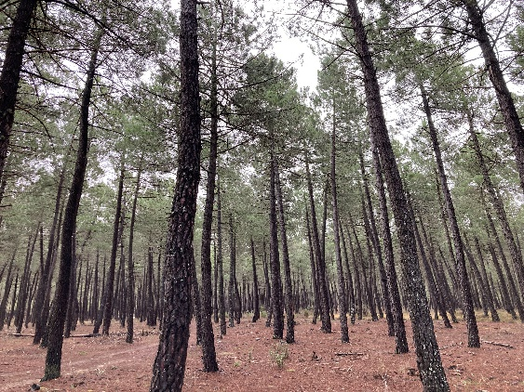
LIFE calls 2025
Published on 24 April 2025
SAPs - Nature and Biodiversity – ddl for submission of proposals 23 September 2025
- CLIMA Adaptation and Mitigation- ddl for submission of proposals 23 September 2025.
Strategic Nature Project (SNaPs) – 4 Sep 2025, 17:00 / 5 Mar 2026, 17:00 (CET)
Strategic Integrated Projects (SIPs) – 4 Sep 2025, 17:00 / 5 Mar 2026, 17:00 (CET)
Technical Assistance (TA-PP: support to the preparation of SNaPs and SIPs)
Technical Policy and Assistance for Replication (TA-R): ddl for submission proposals 23 September 2025.
Legislative priorities projects (PLP):ddl for submittion of proposals 23 September 2025
Topic 2.1: Strengthening foresters’ skills in biodiversity friendly forest management
More info: LIFE Call documents Funding & tenders (europa.eu)
LIFE19 CCA/ES/001181 - LIFE SORIA FORESTADAPT

Slide 20
Help in Preparing Applications
Look again the recording and presentations of the EU infodays at Home: EU Life Info Days 2025
Read the call documents and FAQs on the Funding and Tenders Portal
Your National Contact Point can provide advice and suggestions on your proposal
You might be inspired by ongoing projects (see https://webgate.ec.europa.eu/life/publicWebsite/search) – but beware that requirements may have changed
For clarifications on the call documents, send an email to CINEA-LIFE-ENQUIRIES@ec.europa.eu – your question and answer may be posted in the FAQ list for transparency

Slide 21
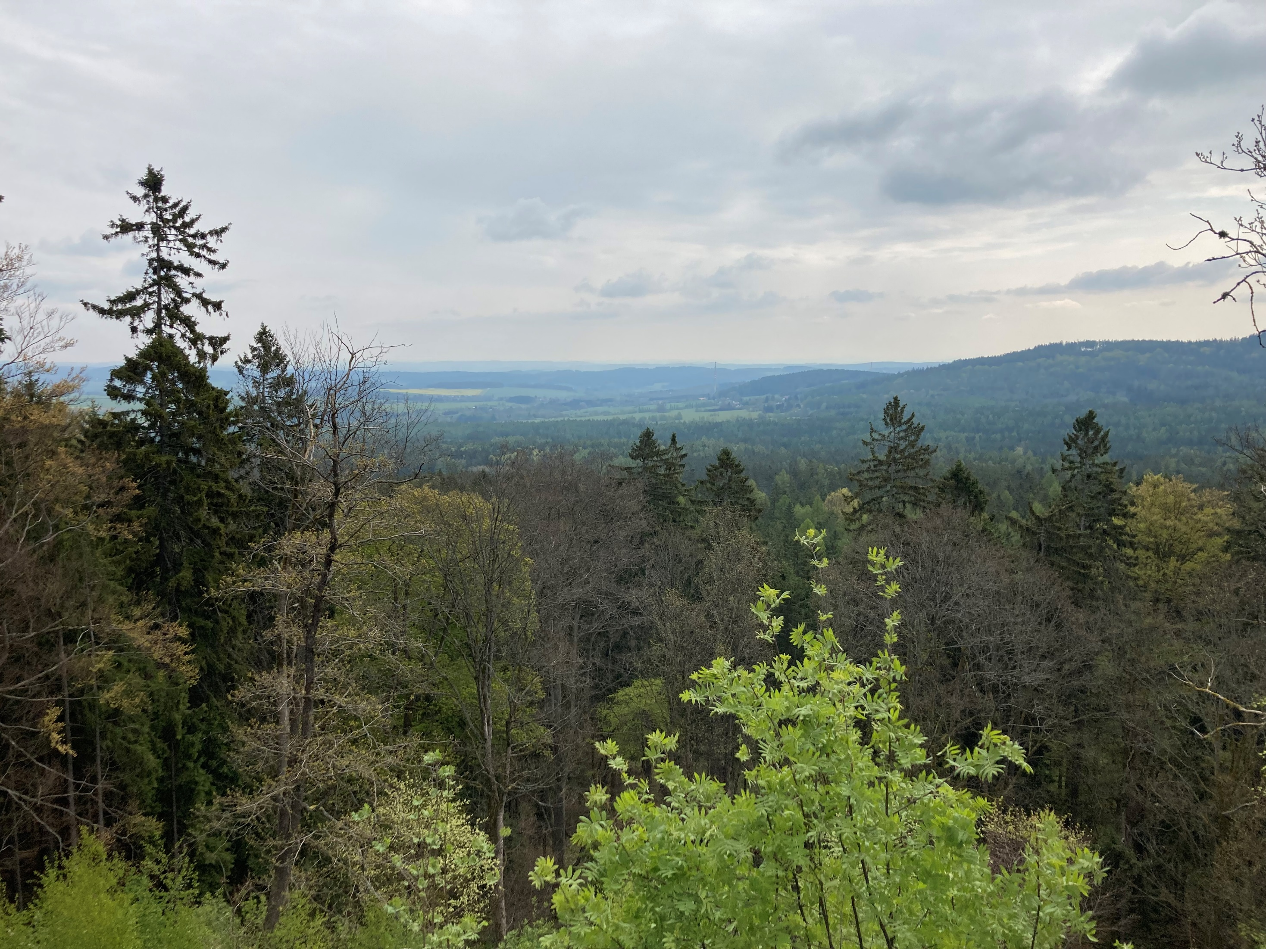
Forest restoration Platform Participants,
Please, be vocal, discuss and share your knowledge, experience, ideas and inspiration to preserve and restore the EU forests

Slide 22
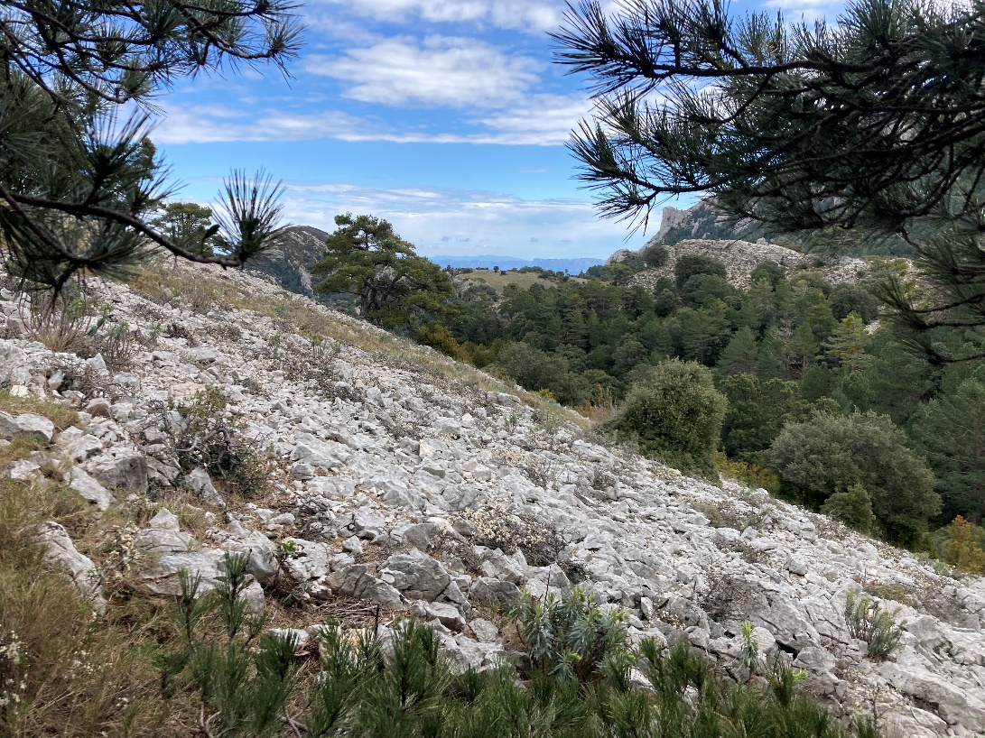
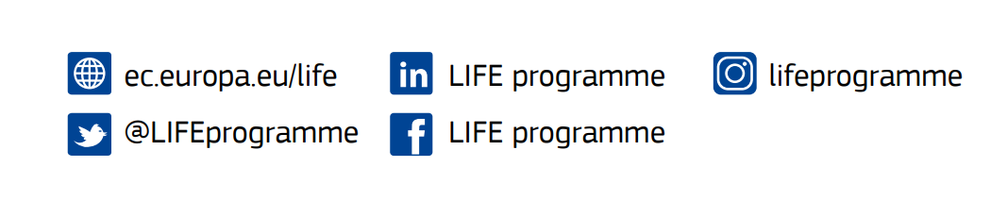

Thank you!
For more information: CINEA-LIFE-ENQUIRIES@ec.europa.eu
Call for proposals: #EULife25

